Slide 1

DATA SCIENCE PROJECT COVID -19 ANALYSIS IN INDIA
Data Science project
Analysis of Covid -19 in India
Name: M Lakshmi Narasa Reddy
Registration number:11902757
Course code: INT217
Section: KM002
Roll No: 59

Slide 2
Contents
Introduction
Objectives
Sources of Data Sets
ETL Process
Analysis
Results
References
Bibliography

Slide 3
Introduction
Coronavirus disease 2019 (COVID-19) is a contagious disease caused by severe acute respiratory syndrome coronavirus2 (SARS-CoV-2). The first known case was identified in Wuhan, China, in December 2019. The disease has since spread worldwide, leading to an ongoing pandemic. More than a year has passed since and the virus is still wreaking havoc in many nations including especially the US and India.

Slide 4
Objectives
In this study we cluster the states of India in terms of the spread of COVID-19 and related variables such as active cases, total Positives, Deaths etc and the Population of the state
Building a Search Board
Dashboard of Covid 19 across India
Visual Representation of Covid 19 across states
Vaccination Tracker
Visual representation of vaccination across states
Population Analysis

Slide 5
Sources
https://www.covid19india.org/
It is an open-source website where anyone can get the data and use it for the educational purposes
https://www.mohfw.gov.in/
It is managed by ministry of MINISTRY OF HEALTH AND FAMILY WELFARE.
https://en.wikipedia.org/wiki/List_of_states_and_union_territories_of_India_by_population
It is the Wikipedia page where the population data of various states is available from 2001 census.

Slide 6
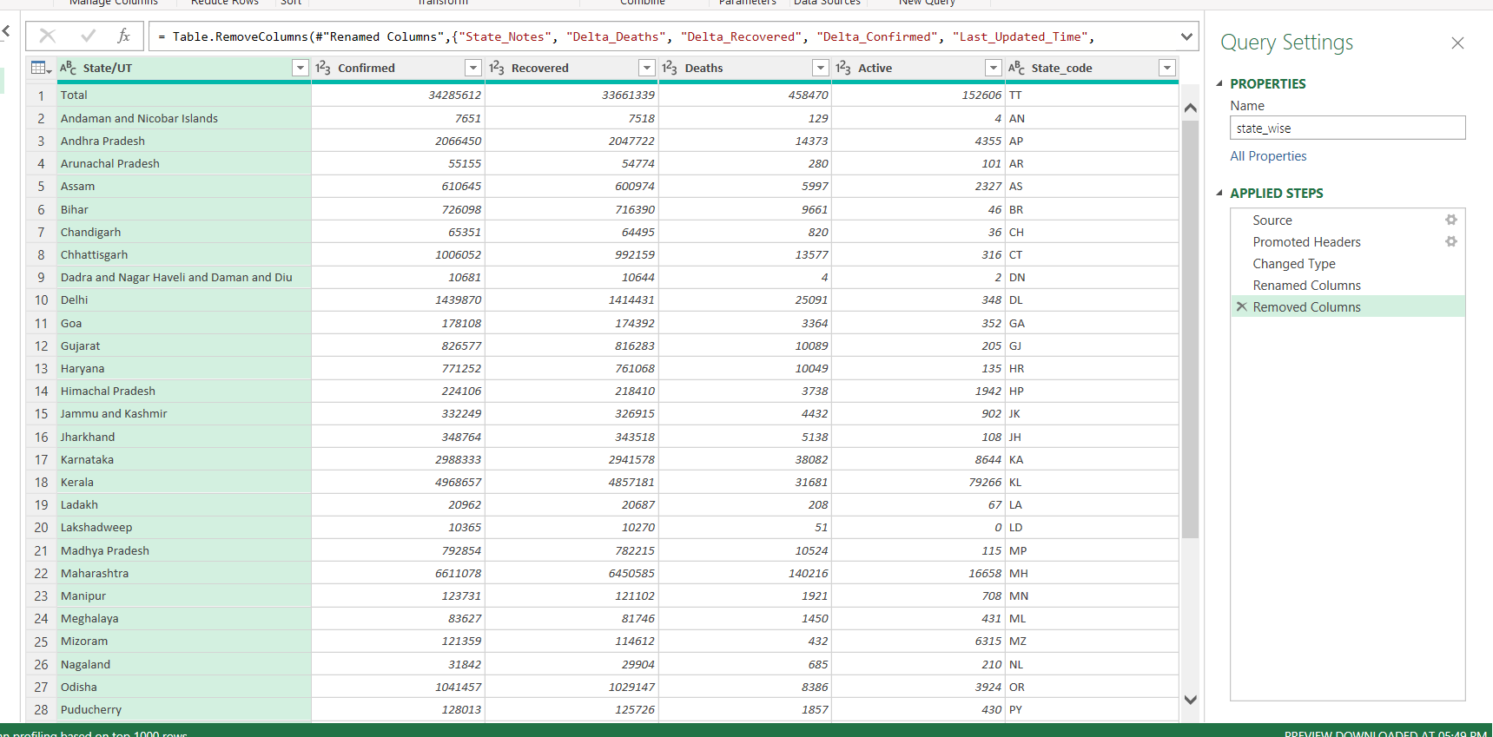
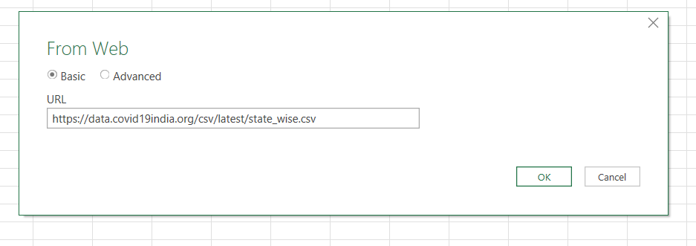
ETL Process
1. State wise covid Data

Slide 7
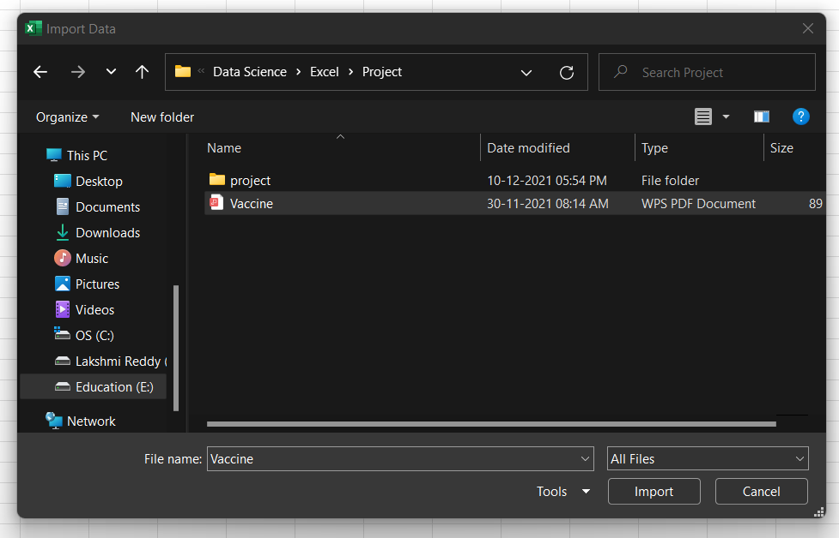
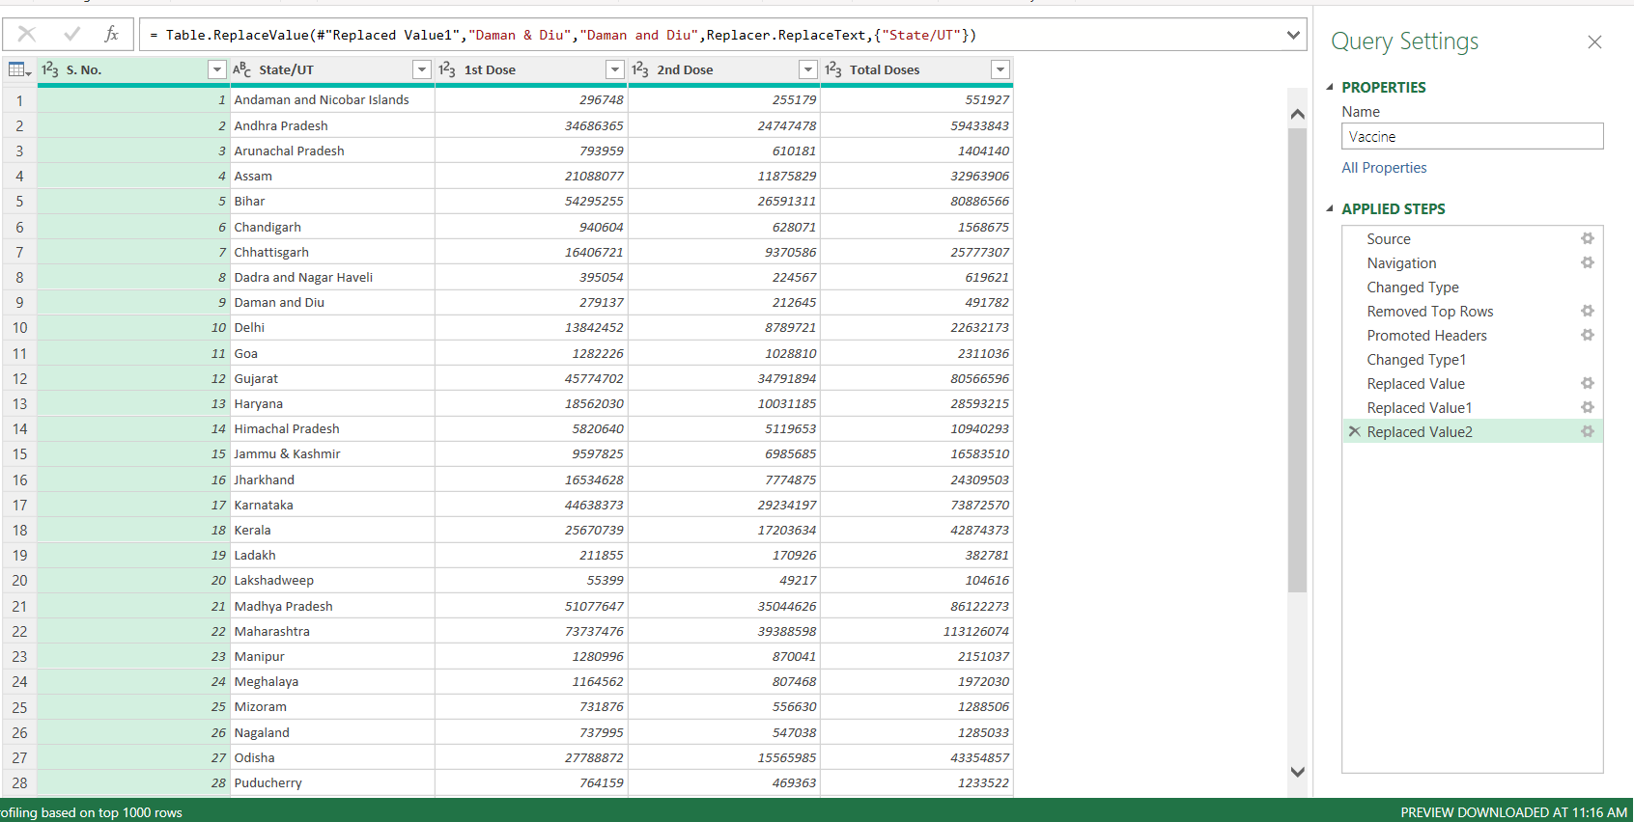
ETL Process
2. Vaccine Data

Slide 8
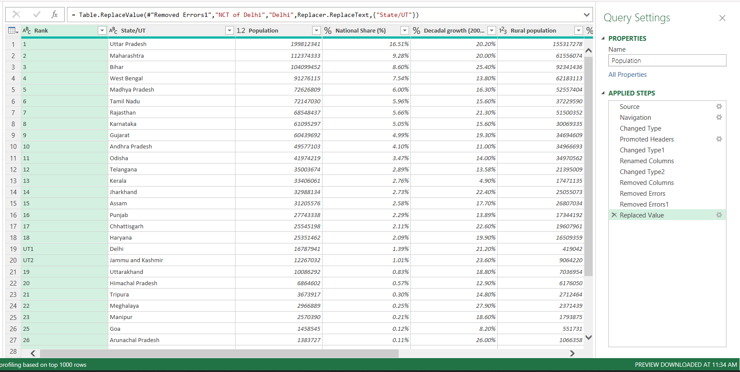
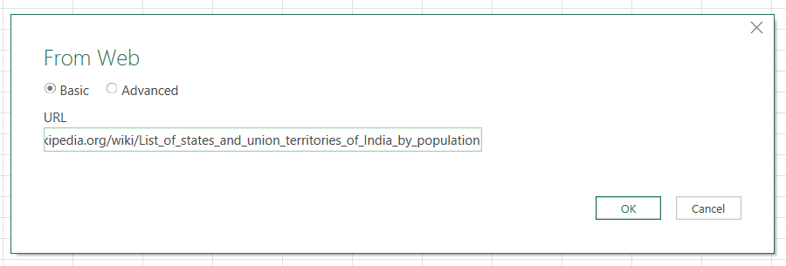
ETL Process
3. State wise Population Data

Slide 9
Covid Analysis
State wise Covid Analysis

Slide 10
Covid Analysis
Top 10 States with Covid-19

Slide 11
Covid Analysis
States with less Covid-19

Slide 12
Covid Analysis
States with high Recovery Rate

Slide 13
Covid Analysis
States with less Recovery Rate

Slide 14
Vaccine Analysis
Comparison of Doses

Slide 15
Vaccine Analysis
Top 10 fully Vaccinated States

Slide 16
Vaccine Analysis
States with less Total Vaccinations

Slide 17
Population Analysis
States Population vs Confirmed Cases

Slide 18
Population Analysis
Top 10 Populated states vs Vaccinations

Slide 19
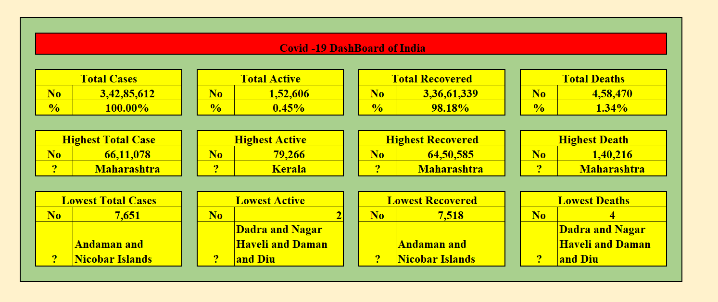
Results

Slide 20
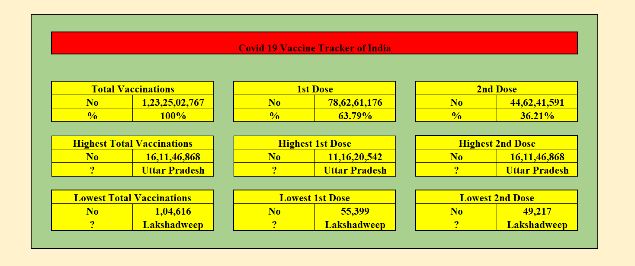
Results

Slide 21
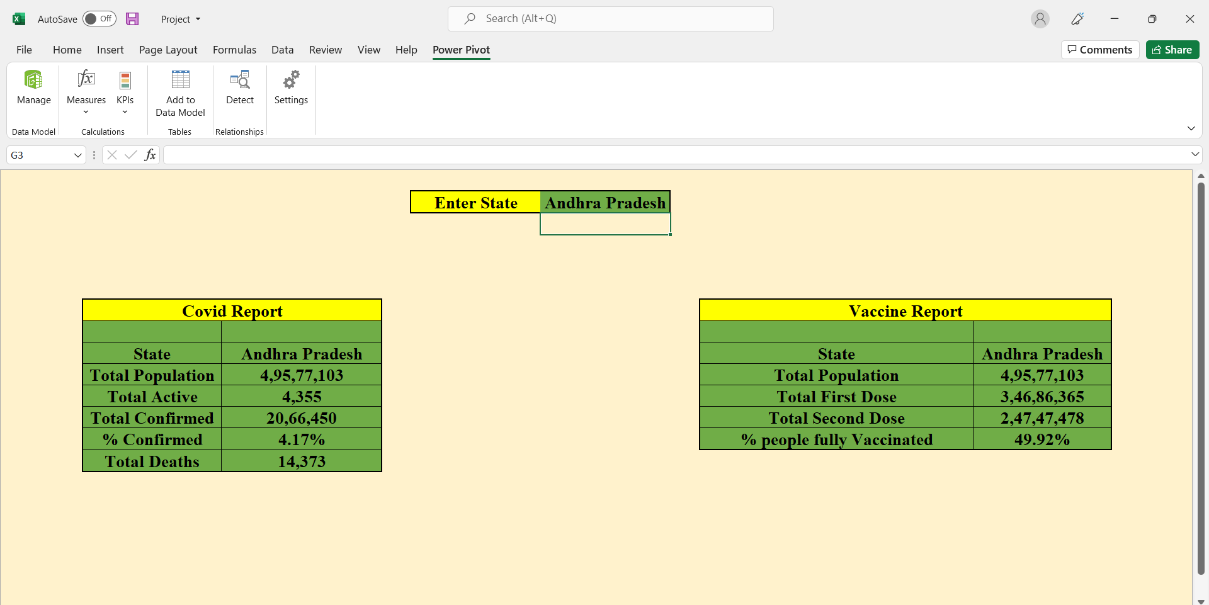
Results

Slide 22
References
https://www.covid19india.org/
https://www.mohfw.gov.in/
https://en.wikipedia.org/wiki/List_of_states_and_union_territories_of_India_by_population
https://data.covid19india.org/csv/latest/state_wise.csv
https://www.mohfw.gov.in/pdf/CummulativeCovidVaccinationReport09december2021.pdf

Slide 23
Bibliography
https://www.covid19india.org/
https://www.mohfw.gov.in/
https://en.wikipedia.org/wiki/List_of_states_and_union_territories_of_India_by_population
https://data.covid19india.org/csv/latest/state_wise.csv
https://www.mohfw.gov.in/pdf/CummulativeCovidVaccinationReport09december2021.pdf

